Slide 1
Professional Learning Facilitators
Nicolette Smith- Social Studies AYA
Washoe
Amy Horonzy- EC Generalist
Douglas
Jenny Chandler- Social Studies AYA
Carson/Lyon
Stacy Drum- Literacy EMC
Washoe
Barbara Barker- MC Generalist
Washoe
Rachel Croft- MC Generalist
Churchill
Notes:
Please introduce yourself and give a brief description of your instructional context right now, hi I am ….I teach at …… (make sure you say what district- we have 6 districts in attendance) I teach ---grade

Slide 2
NV NBC Cohort is sponsored by:
Washoe Education Association
Tom Stauss
Executive Director
Natha Anderson
President
Northwest Regional Professional Development Program (NWRPDP)
Notes:
Rachel- please introduce Natha and Tom- they will speak about WEA for 3-5 minutes

Slide 3
Goal: Strengthened Career Continuum for all Teachers
Notes:
Nicolette
This career continuum shows the alignment between NBPTS and the NEA.
The blank box references to this question that we ask educators: How do you see yourself as a leader?
Review the material in the links prior to addressing this slide - it will give you a clear picture.
On this slide, NEA Career Continuum is in blue while the NBPTS is in other colors.
Detailed information on the NEA Career Continuum: http://162.230.210.194/RandD/Association/NEA%20PSP%20-%20Teacher%20Career%20Continum%202012.pdf
Detailed information on the NBPTS Career Continuum: http://www.nbpts.org/developing-career-continuum
Materials: none
Tell Participants:
SAY: This diagram shows how NEA and NBPTS views our career continuum.
NEA - Preparing & NBPTS - Pre-service teacher - Student teaching, etc
NEA - Emerging & NBPTS - Novice Teacher – Think about that new teacher (new doesn’t necessarily mean 1st year-could be working in a new assignment). They are working on their classroom practices, become involved with professional development, start learning the importance assessing and advancing student learning, exploring their teacher behavior and disposition.
NEA - Professional & Professional teacher - These teachers have a bank of experience and may even be “experts” in certain aspects of teaching, yet still with gaps in their practice or an expressed desire for growth opportunities. They are continuing to work and improve their classroom practices, seek professional development that continues to improve their practice, starting to see how assessing advances student learning, learning what works and doesn’t work for their classroom.
NEA - Accomplished & NBPTS – Board Certified: These teachers are expert practitioners with broad and deep experience and skills. They constantly seek to improve their instructional practice; they participate in professional development that improves their teaching and supports collaboration with peers; they recognize assessment as a tool for advancing student growth; and they reflect on effective practices that support student learning. Teacher mentors.
NEA - Leader & Expertise - Master teacher, teacher leader, school leader, candidate support provider. Fill in the blank – What do you see yourself at this point in your career? Turn and share with your table group.
Share out. (2 minutes)
The NEA is really here to support candidates/teachers/ throughout your career.

Slide 4
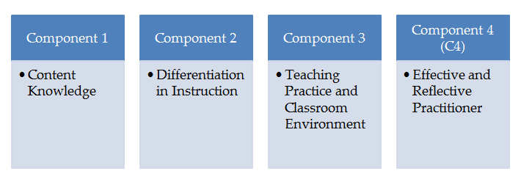
The National Board Process
Evidenced by:
Assessment Center
Evidenced by:
Student Work
Evidenced by:
Video
Evidenced by:
Data
Notes:
Nicolette

Slide 5
How will my portfolio be scored?
Total score is a weighted average
CRE 1= 6.67%
SRI = 20% of total score
C 2
15% of total score
C 3
30% of total Score
C 4
15% of total Score
CRE 2= 6.67%
CRE 3= 6.67%
SRI= 20%; CREs = 20-%
40% of Total Score
C2, C3, C4 Composite Score
60% of Total Score
Floor score minimum of 1.75 for each color:
Unweighted average of 3 CREs and SRI section
Unweighted average of 3 portfolio components
© 2017 National Education Association (NEA). Materials not for distribution or use without expressed permission of the NEA.
Feedback on materials should be directed to jumpstart@nea.org
Notes:
Nicolette
Time: 2 min
Trainer Notes: Don’t get bogged down on this slide. The important thing is that C1 gets an average score and is worth 40% and C2, 3 and 4 get an averaged score and is worth 60%. Remind candidates to write down their questions on post-it notes and post to the Parking Lot.
Materials: none
Tell Participants: This slide represents the scoring for the National Board Certification assessment pieces.
The blue cylinders are Component 1. Component 1 is 40% of the overall assessment: on the left, there are 45 selected response items (SRI)s. This is half of the C1 score and the blue cylinder on the right is the three constructed response exercises, or CREs, which together is the other half of the C1 score. (20% SRI + 20% CREs = 40% of the overall assessment).
The orange cylinders are for C2, C3 and C4. Together, they comprise 60% of the overall score with C2 at 15%, C3 at 30% and C4 at 15%.
When you get scores, you’ll get 4 scores for C1 (SRI score + 3 scores for the CREs). You’ll also get the average of the C1 scores.
You’ll get a score for each component 2, 3, and 4 AND a score for the average of the 3 together.
Each of these averages must be above a minimum score of 1.75. 1.75 is NOT a proficient score, but simply means that NB will not certify a teacher with an averaged score lower than 1.75 for either of the two average scores.
In 2017 National Board will release the score that is required for a candidate to meet or exceed in order to certify.
For more information and a more thorough explanation of scoring, please go to:
http://boardcertifiedteachers.org/sites/default/files/score_release/First_time_Score%20Release%20FAQs.pdf
Q: What are the minimum score requirements?
A: There are three score requirements in order to achieve National Board Certification. They are:
• Assessment center section average score of at least 1.75 – The unweighted average score of
the three constructed response items raw rubric scores and the selected response item section
converted score must be at or above 1.75.
• Portfolio section average score of at least 1.75 – The unweighted average score of the
three portfolio component raw rubric scores must be at or above 1.75.
• Total weighted scaled score at or above the cut score - To be determined in 2017 after
standard setting.
Have any questions? Write your questions on post-it notes and post them on the Parking Lot.

Slide 6
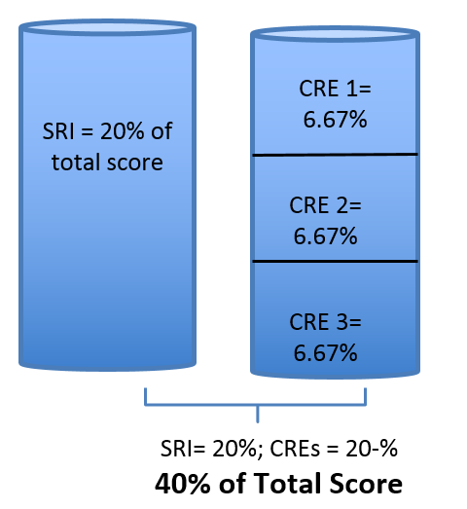
Component 1
Assessment Center-Computer based
CRE- 3 items
Constructed Response Exercise
Generalist/literacy assessment
focuses on content and pedagogy
Content areas i.e. social studies,
science, math, etc. assessment
focuses on content knowledge
SRI- 45 items
Selected Response Items
For all certificates the assessment
focuses on content and pedagogy
Notes:
Nicolette

Slide 7
Component 2
Differentiation in instruction
Highlights your ability to evaluate learning strengths and needs for individual students; plan and implement appropriate differentiated instruction for those students; and provide artifacts of student growth
as evidence of impact
Plan
Do
Study
Act
Repeat
Notes:
Nicolette

Slide 8
Component 3
Teaching Practice and Learning Environment
The dreaded video component!!!
We don’t “start” this Component until February, but if you are planning on completing this Component in 2017-2018 you need to start filming now!!
- Candidates will submit 2 videos that provides evidence of your practice and analysis as it relates to instruction, student engagement, and classroom environment
Notes:
Nicolette

Slide 9
Component 4
“The Beast” highlights your ability as an effective and reflective practitioner in developing a class profile (based on multiple points of data), identifying student and professional needs, planning for impactful student learning, and effectively using assessments to determine growth…
that’s all!!!
Notes:
Nicolette

Slide 10
SLOs/SLGs
-Identify standards, develop rationale
-Identify Assessments
-Identify Population
-Instructional Strategies
-Set Goals
-Artifact(s)/student growth reflection
Component 2
-Identify Population
-Identify Assessments
-Set Goals
-Design Learning Plan
-Collect Artifacts
-Revisit Goals
-Adjust Learning Plan
-Analyze Artifacts
-Reflection
Component 4
-Identify Population
-Data Collection
-Build Group Profile
-Identify Student Needs
-Identify Professional Need
-Set Goals
-Identify Assessments
-Engage in Professional Learning
-Design Learning Plan to Meet Student Needs
-Collect Artifacts
-Revisit Learning Plan
-Analyze Artifacts
-Reflection
Notes:
Nicolette
Time: 5 minutes
(Project on screen for participants to view as they enter the room.)
Trainer Notes:
Welcome candidates as they enter the room. Guide them to sit with like certificate if possible.
Component 2 Overview is designed as a three and a half hour session with break; Trainer determines when candidates need a break.
Trainer determines appropriate housekeeping (have participants sign-in and get name tent/badge; share restroom locations, internet passwords, printer access, develop group norms, etc.).

Slide 11
The Architecture of Accomplished Teaching
Step 6: Set New Learning Goals
Based on your evaluation of student learning, set appropriate goals for your students.
Step 5: Reflect on Teaching Practice
What would I do differently?
What are my next steps?
Step 4: Evaluate Student Learning
Following instruction, evaluate student learning to see if goals were met.
Step 3: Implement Instruction to Achieve Goals
What instructional strategies would be most effective for meeting goals?
What materials, people, or places can I use to enhance student learning?
How can I vary the learning experiences and teaching strategies to meet the needs of learners?
Step 2: Set Learning Goals
Set high, worthwhile goals appropriate for your students, at this time, in this setting.
Step 1: Know Students and Subject Area
Who are my students?
Where are they now?
What do they need?
In what order do they need it?
Where should I begin?
Notes:
Time: 1 minutes
Trainer Notes:
Materials: Architecture of Accomplished Teaching
Tell Participants:
We just walked through each step of the Architecture of Accomplished Teaching By addressing the questions listed under each step, you just showed description, analysis, and reflection of a lesson.

Slide 12
This table is from November 2017 Guide to NB Certification. Check your guide for recent dates.
2017-2018 Important Dates and Deadlines
Registration Window | April 1, 2017 – January 31, 2018
Registration (includes payment of $75 fee) | January 31, 2018
Component Selection (includes payment of component) | January 31, 2018
Change of Certificate and/or Specialty Area | January 31, 2018
Change of Component Selection | January 31, 2018
Withdrawal Deadline | January 31, 2018
Component 1: Content Knowledge Testing Window | April – June 15, 2018
Score Release | On or before December 31, 2018
Portfolio Submission Window | April – May, 2018
Notes:
Nicolette
Time: 5 min
Trainer Notes:
Check the Guide to National Board Certification for the most recent dates and deadlines table.
Materials:
Tell Participants:
Please open to your Guide to National board certification. This table can be found on page the bottom of page 4.
Read through these dates. Tab this chart… you’ll use it on the mapping graphic organizer in a few minutes.

Slide 13
You will need:
Document: What Teachers Should Know and Be Able to Do
Highlighter/pencil
© 2017 National Education Association (NEA). Materials not for distribution or use without expressed permission of the NEA.
Feedback on materials should be directed to jumpstart@nea.org
Notes:
Stacy
Time: 2 minutes
Trainer Notes: Provide preparation instructions to participants; guide candidates to page 8 of their Certificate area standards document, titled “Foundations of National Board Certification for Teachers.” Guide them to the subtitle, “The Five Core Propositions” to read the descriptors of each of the 5 core propositions. Let candidate know this is where they can get a brief overview of the Core Prop. (Not what they are reading for the next activity.)
Materials:
Descriptors of The Five Core Propositions (located in certificate area standards document)
Each candidate needs a copy of What Teachers Should Know and Be Able to Do-(link: http://www.nbpts.org/sites/default/files/what_teachers_should_know.pdf)
Supplies: highlighter/pencil, poster pads for group writing
Tell Participants:
The document known as What Teachers Should Know and Be Able to Do is also referred to as the 5 Core Propositions. We will read the descriptors of The Five Core propositions .
Read the slide.

Slide 14
1.Teachers are committed to students and their learning.
2. Teachers know the subjects they teach and how to teach those subjects to students.
3. Teachers are responsible for managing and monitoring student learning.
4. Teachers think systematically about their practice and learn from experience.
5. Teachers are members of learning communities.
5 Core Props
Notes:
Stacy
Time: 2 minutes
Trainer Notes: Either the trainer can read them or elicit candidate participation. You can make connections here to standards that exist in your state or district.
Materials: Handout of 5 Core Propositions (some candidates will come with this printed already)
Tell Participants:
Teachers will all receive a 5 core prop card with their name tag- they must create groups of 4-5 for each core prop. Re-situate yourself with this temporary partner and annotate the 1 section you have been assigned

Slide 15
5 Core Propositions- Tab 1
1. Explore your assigned Core Proposition- annotate the big ideas of this Proposition (7 minutes)
2. Apply your learning to create a poster to make connections between the Core Proposition and what this Prop looks like in your instructional practice (10 minutes)
Notes:
Stacy- each candidate received a colored Core Prop card when they signed in, have them annote the proposition they were assigned, they will have 7 minutes- get as far as you can- if you finish read the others. When they hear the chime- ask them to stand and find a Core Prop oster that matches theirs groups should be 3-5 maximum- next slide
Trainer Notes: 7 minutes
MAKE SURE CANDIDATES ARE READING THE WHOLE CORE PROP, NOT JUST THE PARAGRAPH DESCRIPTOR. IT SHOULD BE TWO OR THREE PAGES.
Materials: Poster Paper
Tell Participants:
Count off by 5’s.
Directions for Activity
Read 6 min. (What Teachers Should Know and Be Able to Do), identify big ideas (highlight or underline), ready to share with group. 1’s read Core Prop 1. Highlight big ideas. (same with other 4 props)
After reading your assigned core prop, all 1’s get up and move to one spot in the room, etc..
6 min. Discuss and create a poster in “like core prop group” what candidates need to know and how it impacts student achievement.*Trainers: please make sure each group has paper / markers to record vital information

Slide 16
Core Proposition Expert Groups
Group Poster:
Core Proposition in 7 words
Apply this learning to your own context- What does this Core Prop look like in action in your classroom or in your writing?
Notes:
Stacy
Trainer Notes: 10 minutes- go to the poster for the prop you read, introduce yourself and as a group write your prop in 7 words, and list as many examples as you can that would show this prop in your class and or writing
Have candidates make a poster for each of the core props to refer in each academy.
MAKE SURE CANDIDATES ARE READING THE WHOLE CORE PROP, NOT JUST THE PARAGRAPH DESCRIPTOR. IT SHOULD BE TWO OR THREE PAGES.
Materials: Poster Paper
Tell Participants:
Count off by 5’s.
Directions for Activity
Return to “home group”
25 minutes: Gallery walk to each Core Proposition Poster around the room (move clockwise) (Trainer assign designated start poster)
Person who created the poster, shares the essential ideas from that core proposition.

Slide 17
Gallery Walk
Take 10 minutes to review the posters for the Core Propositions you did not work on
What great ideas can you glean from the other posters? Jot them down in your books! Or take pictures!
Take some sticky notes with you to add any great ideas you use to the posters **Everyone try and add at least 1 new idea to 3 different posters!**
Ready To Launch
© 2017 National Education Association (NEA). Materials not for distribution or use without expressed permission of the NEA.
Feedback on materials should be directed to jumpstart@nea.org
Notes:
Amy- while the groups are working on their posters we need to make sure everyone gets some sticky notes for this activity- we will all hand out 3 sticky notes to everyone.
Time: 10 minutes
Trainer Notes: Objective: Candidates will be able to identify their practice within the Five Core Propositions. Take a break after this slide (Please monitor your time and where you are with your candidates - this will determine the length of the break. Check parking lot for questions during and after break.
Materials: Participants will need a writing tool and post-it notes
Have any questions about the Five Core Props? Write your questions on post-it notes and post them on the Parking Lot.

Slide 18
Notes:
Amy

Slide 19
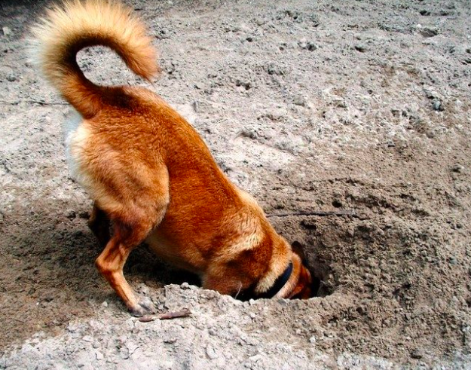
Digging Into Your Standards
Notes:
Jenny

Slide 20
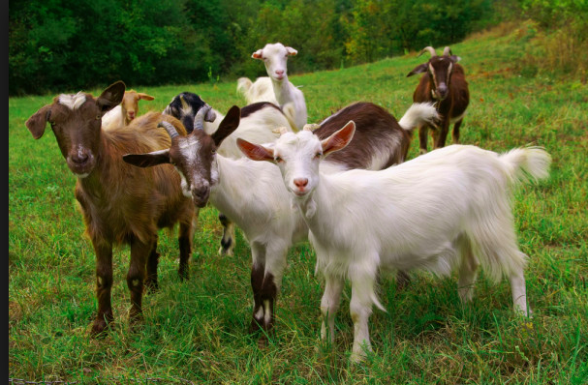
Find your standard that addresses “Diversity”:
In standards document:
Table of Contents: Titles
Standards Statements: Overviews
Full Standard: Topic Headings
Notes:
Jenny
Time: 3 minutes to get out standards binder.
Trainer Notes: The Standard number varies from certificate area to certificate area, and diversity can be addressed by more than one standard, suggest that participants “tab” each standard
Materials: Each candidate will need a copy of their certificate area standards, including the index; tabs for binder materials
Tell Participants:
In this Jump Start Academy, we’ll be working with the standard about Diversity.
Please get out your standards binder.
Each of the four components required for your National Board Certification hold you accountable for providing evidence of your accomplished practice in particular standards. These standards may be found in one component, or in multiple components. The ‘Diversity’ standard is commonly found in Component 2: Differentiation in Instruction.
Sometimes a standard’s title tells exactly what you’re seeking. The next three slides will show how to find standards.

Slide 21
Close Reading Protocol
“Diversity” Standard:
Underline big ideas.
Draw a line from big idea to margin. Write how your practice connects.
Mark questions and gaps in current practice with a ? mark.
Try inserting your own name where it reads “Accomplished teachers…” This will help you add context to what YOU do that meets this standards
Notes:
Jenny
Time: 5 minutes
Trainer Notes: Math and English as a New Language Candidates will need help finding the diversity standard.
Diversity Standards:
-Commitment to Mathematics Learning of all students
-For ENL use Standard III
Provide an overview of the close reading protocol.
Go through protocol and graphic organizer.
You will model first how to do the Close Reading Protocol,
then how to transfer essential ideas to the standards condensed graphic organizer (the next 3 consecutive slides)
Materials: Close reading protocol, standards, Condensed Standard Graphic Organizer
Tell Participants:
Close reading is a researched based literacy strategy that you can use in all content areas that gives students a focus as they read through text.
Close reading refers to the careful & sustained interpretation of a brief passage of text.
Close reading emphasizes the single and the particular over the general.
The reader is cued to pay close attention to individual words, syntax, and the order in which the sentences unfold ideas, as the reader scans the line of text.
Tell Participants:
Ask participants: What does this look like in the classroom?
Direct them to talk with elbow partners about their thoughts on this question?
The verbs help identify what accomplished teachers do in their practice.
Growth Mindset: Identify places where you may not recognize or “see” accomplished teaching in your practice. Establish a plan of action to implement for growth and improvement
We’ll be using this Close Reading Protocol throughout JumpStart.

Slide 22
Are The Standards Even That Important? YES!!!
Language
Best Practices Examples
Guide to what NBPTS wants to see in your writing
Notes:
Jenny
Time: 3 minutes
Trainer Notes: Stress how helpful this graphic organizer to the candidate’s national board process.
Materials:
Tell Participants:
The condensed standard graphic organizer can be very helpful to you as a candidate.
Use the condensed standard graphic organizer as a menu of your practices from each standard to intentionally embed in the planning for your lesson/unit/ in your component. Choose the high leverage practices that most significantly impact student learning. No room for fluff or pointless activities.
Once your written your commentary, use the condensed standard graphic organizer as a checklist of the evidence you wrote about. How many checks did you write about for each of the standards? How much evidence do you need to show that you are CLEAR, CONVINCING and CONSISTENT?
Each learning experience we offer students has the potential to go even better. Identify your question places on the condensed standard graphic organizer and reflect on how you overcame those barriers, or the plan for improvement if you still didn’t meet the mark. Accomplished Teachers are not perfect teachers. We are teachers who systematically reflect on our practice and learn and grow from successes and from challenges. (Core proposition 4)

Slide 23
Standards Condensed Graphic Organizer
Notes:
Jenny
Trainer decide when and how to share this graphic organizer; before reading, or after reading.
Time: 6 minutes
Trainer Notes: Explain the importance and how to use the graphic organizer throughout their National Board process. Highlight the importance of the Standards. Use the graphic to help candidates transfer the notes that captured from their close read. It would be great to model this on a document camera.
Materials: Graphic Organizer
Tell Participants:
This graphic organizer is a great tool to help you lay out the evidence for each component that you capture as you close read each standard.
So, let’s get started. Any volunteers?
What is your standard number? List the standard number in the 1st column.
What is the title of your standard? List the standard title in 2nd column.
Put the standards in your own words. What do accomplished teachers do to show this standard? For time sake, just give me a few statements. List this information in the 3rd column.
What do you already do in your classroom that meets this standard? List this information in the 4th column.
What areas you will need to grow to meet this standard? List this information in the 5th column.
Any questions?
Remember….It is helpful and your responsibility to do this for each of your standards. This will help you align what you already do with the standards and the things you want to work on.

Slide 24
Work Time
Read Whole Standard that addresses “Diversity” (20 min.)
Highlight /underline key verbs or ideas:
What teachers “do”
Draw line from big idea to margin
Connect to your practice
Identify gaps with a ?
4. Record on Condensed Standards Graphic Organizer –If you complete this standard, start working on another standard in your certificate
© 2017 National Education Association (NEA). Materials not for distribution or use without expressed permission of the NEA.
Feedback on materials should be directed to jumpstart@nea.org
Notes:
Jenny
Time: lets check what the time is, and we will decide how long we will let them work according to the time
Trainer Notes: Candidates will get to read for 20 minutes. Keep the room silent for the reading. If possible, construct a model using a document camera with you reading and writing on your standards. Walk around and monitor. Check the parking lot for questions and encourage candidates to post questions. Often, candidates will ask you questions that might be good to address as a group.
Materials: Diversity Standard, timer
Tell Participants:
You are now going to have an opportunity to read the ENTIRE Diversity Standard for 20 minutes. There is not talking during the reading time. As you are reading, highlight/underline key verbs (What you “do”). The verbs help YOU identify what accomplished teachers do in their practice.
The first time you will read to connect your practice to the NB standards. Draw line from big idea to margin and write down how this is reflected in your classroom. The 2nd time read to identify gaps. It will be helpful to have a different color for each time your time.
After 20 minutes
Now it is time to fill out your graphic organizer. We went through the directions on the prior slide. Are there any questions?
If not, you will get 18 minutes to work with a partner on this section.

Slide 25
SLOs/SLGs
-Identify standards, develop rationale
-Identify Assessments
-Identify Population
-Instructional Strategies
-Set Goals
-Artifact(s)/student growth reflection
Component 2
-Identify Population
-Identify Assessments
-Set Goals
-Design Learning Plan
-Collect Artifacts
-Revisit Goals
-Adjust Learning Plan
-Analyze Artifacts
-Reflection
Component 4
-Identify Population
-Data Collection
-Build Group Profile
-Identify Student Needs
-Identify Professional Need
-Set Goals
-Identify Assessments
-Engage in Professional Learning
-Design Learning Plan to Meet Student Needs
-Collect Artifacts
-Revisit Learning Plan
-Analyze Artifacts
-Reflection
Notes:
Nicolette
Time: 10 minutes
(Project on screen for participants to view as they enter the room.)
Trainer Notes:
Welcome candidates as they enter the room. Guide them to sit with like certificate if possible.
Component 2 Overview is designed as a three and a half hour session with break; Trainer determines when candidates need a break.
Trainer determines appropriate housekeeping (have participants sign-in and get name tent/badge; share restroom locations, internet passwords, printer access, develop group norms, etc.).

Slide 26
Linking Your Thinking
-Component 2 focuses on evidence that you are effectively differentiating for all students
© 2017 National Education Association (NEA). Materials not for distribution or use without expressed permission of the NEA.
Feedback on materials should be directed to jumpstart@nea.org
Notes:
Nicolette
Time: 0 minutes (of 23 minutes; slides 9-13)
Trainer Notes:
This is a transition slide for first section.
Materials:
None
Tell Participants:
In the Foundations section we explored National Board’s 5 Core Propositions.
In this session, we will link The 5 Core Propositions with Component 2 – Differentiation in Instruction.

Slide 27
How can we differentiate?
Teachers can differentiate in four key areas:
Content
Offering students choice within the content you are already teaching is a great way to differentiate content that meets both your needs and the students interests
Process
We don’t all learn the same way, make sure that you plan with different learners in mind and you units have a balanced inclusion of different processing opportunities
Product
Differentiating students product is a fun and easy way to offer them choice and tend to their learning styles too
Environment
We often see differentiation of environment more in ES classrooms, stations and even small changes in the classroom environment changes a mood, tone, and expectations for all students
Notes:
Nicolette

Slide 28
Teachers Differentiate
Content
Process
Product
Environment
What we teach and how it’s presented
Sense making activities & assessment
Summative assessments/ Transfer Goals
How it feels in the classroom
For Students
Learning Profile
Readiness
Interest
Preparing for different student ability levels
Allowing students to make good choices
Utilizing student preferences, culture and thinking styles
Notes:
Nicolette
Content- using different teaching modalities, lecture, discussion, etc. and content, maybe some students get to choose details within a content area, i.e. kinder teachers who are studying “rainforest” and within that the students read the book and were able to explore topics
Process- graphic organizers, discussion, questioning, etc.
Product- how students show their learning
Environment- flexible seating, flexible grouping, quiet space, options for movement
Readiness- what are students reading levels? Ability to access content? Scaffolding greatly important here
Interest- Where ca you incorporate choice? Topics to explore, not all content lends itself to specific interests, but this is where you establish the so what who cares about a lot of learning
Learning profile- preferences are often brain related- encourage students to push their own edges because working outside of their comfort zone creates positive disuequalibrium- thinking stulrs are more linear (follows directions- so ikea is a nightmare for them, plans every details of a trip) or global (embraces ambiguity and sees the ikea furniture as a puzzle, just starts driving and plans the trip along the way)

Slide 29
Differentiation is NOT a different lesson for each student!!
Differentiation is teachers planning to promote equity through multiple access points into the curriculum
Notes:
Nicolette

Slide 30
Differentiation in Action
In groups of 4-5 use the large post-it notes to create a list of how teachers can differentiate
Try and create a comprehensive list of all the examples your can think of
Each group will only create a list for one area (i.e. content or process, not both)
Teachers
Differentiate
-Content
-Process
-Product
-Environment
For Students
-Readiness
-Interest
-Learning Profile
Notes:
Nicolette

Slide 31
Component Exploration
© 2017 National Education Association (NEA). Materials not for distribution or use without expressed permission of the NEA.
Feedback on materials should be directed to jumpstart@nea.org
Notes:
Amy
Time: 0 minutes (of 48 minutes; slides 14-22)
Trainer Notes:
This is the transition slide to next activity
Materials:
Candidates will need Component 2 Portfolio Instructions and Scoring Rubric (Hard copy/Electronic copy)
For electronic copy, click on the Component 2 link for your Certificate Area, select the PDF from the folder. http://boardcertifiedteachers.org/certificate-areas
Tell Participants:
Now we’re going to delve into the instructions document for Component 2.

Slide 32
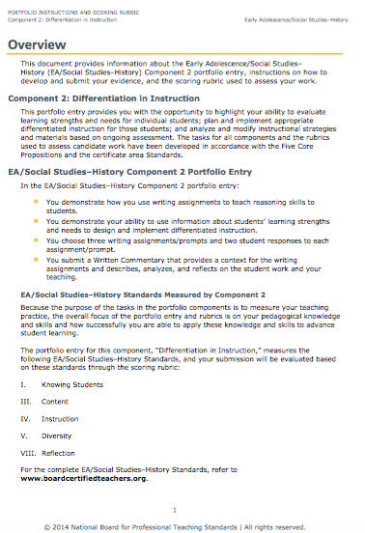
Component Overview
Read your Component 2 Overview.
Highlight key information.
Record questions.
© 2017 National Education Association (NEA). Materials not for distribution or use without expressed permission of the NEA.
Feedback on materials should be directed to jumpstart@nea.org
Notes:
Amy
Time: 8 minutes (of 48 minutes; slides 14-22)
Trainer Notes:
The key concept here is to allow candidates an entry point into their Component 2 instructions, then expand on the basic information with the following activities / exploration.
Materials:
Candidates will need Component 2 Portfolio Instructions and Scoring Rubric (Hard copy/Electronic copy)
For electronic copy, click on the Component 2 link for your Certificate Area, select the PDF from the folder. http://boardcertifiedteachers.org/certificate-areas
Tell Participants:
Read the Overview for your Certificate Area, highlighting key information and record questions.

Slide 33
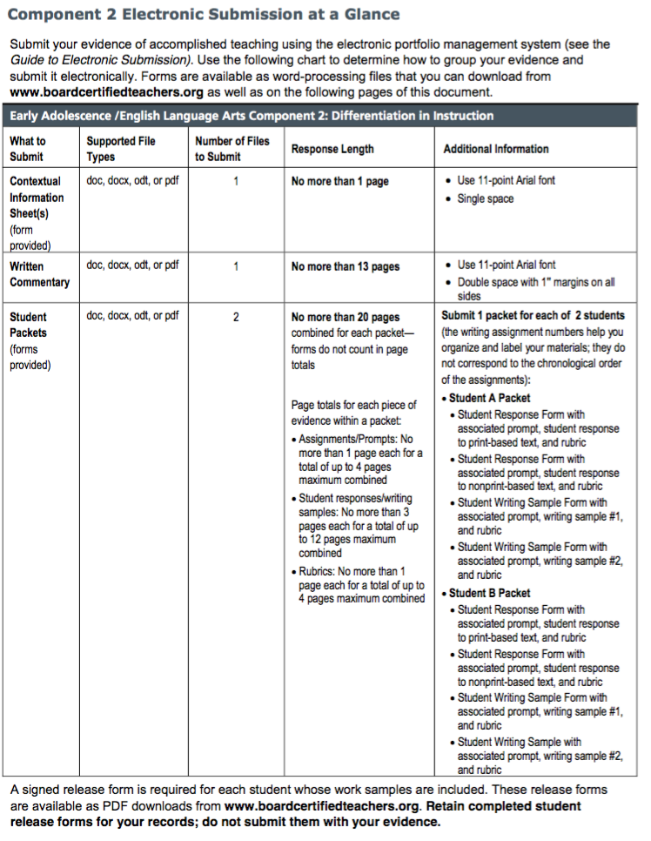
Electronic Submission At a Glance
Refer to the “Component 2 Electronic Submission at a Glance” page.
This is typically found near page 10-13 of your specific Component 2 instructions.
© 2017 National Education Association (NEA). Materials not for distribution or use without expressed permission of the NEA.
Feedback on materials should be directed to jumpstart@nea.org
Notes:
Rachel
Time: 1 minutes (of 48 minutes; slides 14-22)
Trainers Notes:
Have participants refer to the Component 2 Electronic Submission At a Glance. This page shows all materials that must be submitted for this entry.
Materials:
Component 2 Portfolio Instructions and Scoring Rubric (Hard copy/Electronic copy)
For electronic copy, click on the Component 2 link for your Certificate Area, select the PDF from the folder. http://boardcertifiedteachers.org/certificate-areas
Refer to Electronic Submission At a Glance in the Component 2 Portfolio Instructions and Scoring Rubric document, usually around pages 10-13 (may be different for each Certificate Area).
Tell Participants:
Please find the Guide to Electronic Submission typically found near pages 10-13.
Label this page in your instructions with a sticky note; this is a great resource to use when organizing your thinking and your submission.

Slide 34
Goals or Objectives
Educators typically consider:
Goals = overarching unit targets.
Objectives = short-term learning targets.
National Board uses the terms “Goals” and “Objectives” interchangeably.
In your writing it is important that you own the distinction; be clear and consistent in your use of these terms. Alignment is key!!
Notes:
Barbara
Time: 2 minutes (of 13 minutes; slides 31-35)
Trainer Notes:
Help candidates to understand the importance of being clear in their writing.
Materials:
None
Tell Participants:
Consider how teachers usually define goals and objectives.
Know that National Board will refer to goals and objectives interchangeably throughout the Portfolio Instructions.
Be clear and consistent in your use of “goal”, “overarching goals”, and “lesson objectives”.

Slide 35
About the Instructional Context
What are the relevant characteristics of this class that influenced your instructional strategies for this lesson: ethnic, cultural, and linguistic diversity; the range of abilities of the students; the personality of the class? What are the strengths and instructional challenges represented by these particular students?
What Standard does it connect with?
Notes:
Barbara
Time: 2 minutes (of 39 minutes; slides 36-49)
Trainer Notes:
In this text, each question/prompt connects directly with one or more Standards. This information begins to provide evidence of “Knowledge of Students”.
Materials:
None
Tell Participants:
The Instructional Context is a form everyone completes for each Component. It provides an overview of your students.
ASK: Is there a connection between these questions and the Standard you read earlier?
Projected is the prompt taken from the “Instructional Context” form and is typical of all Certificate Areas. This provides an entry point for assessors in understanding your students and their needs. This is connected to the “Knowledge of Students” Standard that you read earlier.

Slide 36
Time To Practice!
In groups of 3-4 read through the “instructional context” form provided
What data could the teacher pull that would help them build a class profile? Individual student profile?
What student needs can you identify from the context provided?
Notes:
Barbara- please adjust instructions as necessary- I am not sure I have enough info here, on the copies I have a space for them to do a data brain dump, what else do we need
Trainer Notes:
Include tips for selecting students (for example, neither highest nor lowest)… emphasize the need to show your impact on student learning.
If needed, offer the following possible examples:
GOAL: Understand characteristics of regular polygons.
ACTIVITY: Sorting polygons.
GOAL: Use text based evidence to support a position.
ACTIVITY: Write a persuasive essay.
Group participants into triads. Choose an option for sharing: shoulder partners, someone from a different Certificate Area or someone from your Certificate Area.
Add ‘Quick Write’ to the Strategy Wall.
Materials:
Sticky Notes
Tell Participants:
Please take out a Sticky Note. Follow the directions on the slide. You’ll have 2 minutes for writing.
Next, share with your two partners. You will have 1 minute each for sharing.

Slide 37
Clear, Convincing, Consistent
Incorporate questions into your answer (Let your assessor know what you’re answering)
Bullets, numbered lists? OK
Incomplete sentences? OK
Refer to NB Writing Resources
Talk it, then write it
Easier to keep to suggested page length than to have to edit out
© 2017 National Education Association (NEA). Materials not for distribution or use without expressed permission of the NEA.
Feedback on materials should be directed to jumpstart@nea.org
Notes:
Amy
Time: 1 minute (of 39 minutes; slides 36-49)
Trainer Notes:
Remind candidates to refer to the General Portfolio Instructions to access writing resources.
Refer to three types of writing and then refer to National Board writing resources.
Materials:
General Portfolio Instructions.
Tell Participants:
Refer to the General Portfolio Instructions: Writing about Teaching.
This will help you to understand the three types of writing: descriptive, analysis, and reflective. They are required as you go through this process.

Slide 38
Connect Feedback to Student Learning Needs
© 2017 National Education Association (NEA). Materials not for distribution or use without expressed permission of the NEA.
Feedback on materials should be directed to jumpstart@nea.org
Notes:
Stacy
Time: 1 minute
Trainer Notes:
Transition slide into the last section for this academy.
Materials:
None
Tell Participants:
How might we think about feedback to support individual student learning needs?

Slide 39
Planning Time
The rest of the time today is yours to work in a learning community to plan for Component 2
Notes:
Stacy

Slide 40
How will my portfolio be scored?
Total score is a weighted average
CRE 1= 6.67%
SRI = 20% of total score
C 2
15% of total score
C 3
30% of total Score
C 4
15% of total Score
CRE 2= 6.67%
CRE 3= 6.67%
SRI= 20%; CREs = 20-%
40% of Total Score
C2, C3, C4 Composite Score
60% of Total Score
Floor score minimum of 1.75 for each color:
Unweighted average of 3 CREs and SRI section
Unweighted average of 3 portfolio components
© 2017 National Education Association (NEA). Materials not for distribution or use without expressed permission of the NEA.
Feedback on materials should be directed to jumpstart@nea.org
Notes:
Nicolette
Time: 2 min
Trainer Notes: Don’t get bogged down on this slide. The important thing is that C1 gets an average score and is worth 40% and C2, 3 and 4 get an averaged score and is worth 60%. Remind candidates to write down their questions on post-it notes and post to the Parking Lot.
Materials: none
Tell Participants: This slide represents the scoring for the National Board Certification assessment pieces.
The blue cylinders are Component 1. Component 1 is 40% of the overall assessment: on the left, there are 45 selected response items (SRI)s. This is half of the C1 score and the blue cylinder on the right is the three constructed response exercises, or CREs, which together is the other half of the C1 score. (20% SRI + 20% CREs = 40% of the overall assessment).
The orange cylinders are for C2, C3 and C4. Together, they comprise 60% of the overall score with C2 at 15%, C3 at 30% and C4 at 15%.
When you get scores, you’ll get 4 scores for C1 (SRI score + 3 scores for the CREs). You’ll also get the average of the C1 scores.
You’ll get a score for each component 2, 3, and 4 AND a score for the average of the 3 together.
Each of these averages must be above a minimum score of 1.75. 1.75 is NOT a proficient score, but simply means that NB will not certify a teacher with an averaged score lower than 1.75 for either of the two average scores.
In 2017 National Board will release the score that is required for a candidate to meet or exceed in order to certify.
For more information and a more thorough explanation of scoring, please go to:
http://boardcertifiedteachers.org/sites/default/files/score_release/First_time_Score%20Release%20FAQs.pdf
Q: What are the minimum score requirements?
A: There are three score requirements in order to achieve National Board Certification. They are:
• Assessment center section average score of at least 1.75 – The unweighted average score of
the three constructed response items raw rubric scores and the selected response item section
converted score must be at or above 1.75.
• Portfolio section average score of at least 1.75 – The unweighted average score of the
three portfolio component raw rubric scores must be at or above 1.75.
• Total weighted scaled score at or above the cut score - To be determined in 2017 after
standard setting.
Have any questions? Write your questions on post-it notes and post them on the Parking Lot.

Slide 41
Nevada Support
Northern Nevada NBC Cohort
www.NVNBCTcohort.weebly.com
@NicoletteMSmith
#NVNBClead
@NVNationalBoard
@NBPTS
Notes:
Time: 5 minutes (Optional)
Trainer Notes:
Use this slide to share resources if you have additional time.
Materials :
Possible handout on local/state Association Professional Development opportunities.
Tell participants:
We also wanted to share information about how to get Professional Development courses and support through our local/state Association.

Slide 42
Next Meetings
Churchill
9/23/17
Numa ES Library
Douglas
9/23/17 PDC
Carson/Lyon
9/9/17
Carson HS Room. 311
Washoe/Storey
9/16/17 380 Edison Way
Homework
Contextual information sheet
Send home filming permission forms
Identify (Carson), collect all data that you plan on using in your group profile

