Slide 1
Effective and Reflective Practitioner
Component 4
Planning for the Edges
Notes:
To view this presentation, first, turn up your volume and second, launch the self-running slide show.

Slide 2
Follow us on Twitter
@NicoletteMSmith or #NVNBClead
www.NVNBCTcohort.weebly.com
For more information about Component 4 visit http://boardcertifiedteachers.org/certificate-areas

Slide 3
How will my portfolio be scored?
Total score is a weighted average
CRE 1= 6.67%
SRI = 20% of total score
C 2
15% of total score
C 3
30% of total Score
C 4
15% of total Score
CRE 2= 6.67%
CRE 3= 6.67%
SRI= 20%; CREs = 20-%
40% of Total Score
C2, C3, C4 Composite Score
60% of Total Score
Floor score minimum of 1.75 for each color:
Unweighted average of 3 CREs and SRI section
Unweighted average of 3 portfolio components
Notes:
Time: slides 5-8 = 5 minutes
Materials:
Notes: This slide appears in each Jump Start Academy. Candidates may have seen this already.
Tell participants: This is the proposed 2016 version of the slide.
http://boardcertifiedteachers.org/sites/default/files/score_release/First_time_Score%20Release%20FAQs.pdf
Q: What are the minimum score requirements?
A: There are three score requirements in order to achieve National Board Certification. They are:
· Assessment center section average score of at least 1.75 – The unweighted average score of
the three constructed response items raw rubric scores and the selected response item section
converted score must be at or above 1.75.
· Portfolio section average score of at least 1.75 – The unweighted average score of the
three portfolio component raw rubric scores must be at or above 1.75.
· Total weighted scaled score at or above the cut score - To be determined in 2017 after
standard setting.

Slide 4
Linking
Component 4
With the
5 Core Propositions
Notes:
Time:
Materials:
Note: Transition slide: No time required on this slide.

Slide 5
The Five Core Propositions
Teachers are committed to students and their learning.
Teachers know the subjects they teach and how to teach those subjects to students.
Teachers are responsible for managing and monitoring student learning.
Teachers think systematically about their practice and learn from experience.
Teachers are members of learning communities.
Notes:
Time: 5 minutes
Materials needed: “What Teachers Should Know and Be Able to Do”
Tell participants: Read “What Teachers Should Know and Be Able to Do” Core proposition 5.
Underline a phrase that resonates with you.

Slide 6
Reading & Reflection
Read the “Overview” on the first page of Component 4’s instructions.
Reflect on the Five Core Propositions.
Which ones connect the most with Component 4?
Notes:
Time: 5-10 minutes
Materials:
Notes:
Tell participants: Read the overview on the first page of Component 4’s instructions. Reflect and think about which of the 5 Core Propositions connect the most with Component 4?
You can add: Look for what hasn’t been covered. You might want to look closer at:
Core Proposition 4: teacher as learner
Core Proposition 5: Learning communities, collaborative, parent-community engagement

Slide 7
Let’s Start to Chip Away at Component 4
Notes:
Just acknowledge to the group that you recognize that this process can seem like too much, but remind them they only have one more component!!

Slide 8
Overview of Component 4
Designed to assess a teacher’s abilities as an effective and reflective practitioner in developing and applying their knowledge of their students.
Within the context of a group profile, provide:
Assessment Data:
Formative
Summative
Participation in Learning Communities regarding:
Professional Learning Need
Student Need
Written Commentary
Notes:
Time: 5 minutes
Materials:
Notes:
Tell participants: This slide provides a quick overview for the candidates with the main ideas of Component 4. In-depth coverage will be provided in activities on subsequent slides.

Slide 9
Instructions are Layered
Make sure you are looking at your General Portfolio Instructions as well!
Variety of evidence. The evidence submitted for Component 2 and Component 4 and one of the two video recordings submitted for Component 3 may be from the same unit of instruction, but must be from different lessons that have unique lesson goals and objectives—even if all evidence is drawn from a single instructional setting.
Notes:
Time: 1 min
Notes: Have participants read the slide, and go to that page in the General Portfolio Direcitons
Tell Participants:
We need to accentuate the importance of reading all information that NB offers to support a candidate’s process:
Component Instructions
General Instructions
Rubrics
Standards
Guide to NB Certification

Slide 10
It might look like…

Slide 11
Notes:
Give one- Get one: Ask participants to get up and discuss with one another an ah-ha that you have had over the last 4 weeks, and 1 concern/question you have

Slide 12
Let’s Check Out Component 4
In like-certificate areas, spend 20 minutes reading the section “What Do I Need to Submit” (p. 5)
Find at least 2 questions you have and write them on post-it notes
Spend 5 minutes in a small group discussing the key elements of this component
What conflicting impressions did you have?
Refer to the text (especially on subsequent pages) to clarify these elements.
Notes:
Time: 30 minutes
Materials:
Notes: After the small group discussion, transition to a large group discussion to have the candidates share out their findings and clarifying as necessary.
This gets candidates digging into their directions. The purpose is to help candidates know they have the materials where they can find the answers on their own. Your job is to guide and facilitate, not be the person with all the answers.
Big Picture Quick overview of the parts of the entry. The presentation ends with an activity that helps candidates see the connections among all of these parts.
Tell participants: Get into like-certification areas (if your group is able) and read the section “What Do I Need to Submit” on page 5. You will have 5 minutes to read the section and then in your small group discuss the key elements of this component. What conflicting impressions did you have? Use the text as evidence.

Slide 13
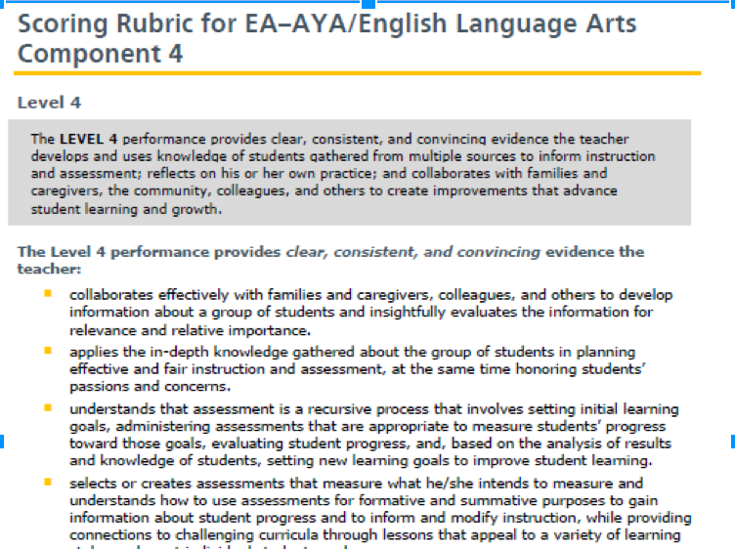
Review the Scoring Rubric
Notes:
Time: slides 14-15 = 25 minutes
Materials needed: Making Connections Organizer, Architecture of Accomplished Teaching
Notes:
Tell participants:
Turn to your level 4 rubric
Explain to the group that this component is very similar for all certificates, there are small differences, but they are not significant.

Slide 14
Close Reading Protocol
Turn to your standards in your bibles:
Locate the standard dealing with assessment.
Notes:
Time: slides 21-27 = 30 minutes
Materials:
Notes:
Tell participants: In your standards, locate the Standards Statements page. This is a succinct statement of each vital aspect of the practice of the accomplished teacher in their certificated area. Read through them looking for the one that most closely aligns to the assessment. In some areas, this concept is in all of your standards, in which case you (or your group) will need to select a single standard to close read.

Slide 15
Strategy: Close Reading Protocol
Read (12 min.)
Highlight /underline key verbs or ideas:
What teachers “do”
Draw line from verb to margin
Connect to your practice
Identify gaps with a ?
Notes:
Time: slides 21-27 = 30 minutes
Materials: highlighters, Condensed Standards graphic organizer, model of standards marking
Note to trainer: If you are time sensitive or candidates have already used the Close Reading protocol then you may delete slides 23-24.
Tell participants: We’ll be using this Close Reading Protocol throughout Jump Start
he verbs help identify what accomplished teachers do in their practice.
Growth Mindset: identify places where you don’t do what accomplished teachers do and you know you’ll need a plan in place to grow/improve.
We’ll be using this Close Reading Protocol throughout Jump Start

Slide 16
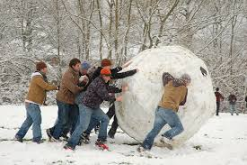
Assessment Snowball Fun!!
Come to a group working definition of
Formative Assessment
And
Summative Assessment
(Snowball strategy)
Notes:
Time: 10 min
Materials: 2 blank poster sheets one formative, one summative
Notes: Divide room in half. One half “formative”; the other half “summative”
In pairs, two candidates come to a common definition of Formative assessment.
That pair joins another pair, now four candidates working together to come to a common definition of Formative… (snowball)
Then, the half of the room focused on Formative comes to a common definition. Write it on a poster and place it on the wall. This is our working definition of formative assessment.
At the same time, do the same thing for the other half of the room focused on summative assessment.
Post both posters

Slide 17
Break the work into smaller pieces!
Notes:
Explain that we think breaking the different parts of the component into smaller pieces can make it feel less overwhelming. So we are giving them time to think about planning for their own success

Slide 18
Making Connections
Component 4
Developing Knowledge of Students
Collaborating with Others
Using Assessment
Participating in Learning Communities
Notes:
Time: slide 16 = 5 minutes
Materials needed: Making Connections Organizer, Architecture of Accomplished Teaching
Notes:
Tell participants:
1. Read through rubric, annotate with strategies that you can use to provide clear, consistent, and convincing evidence

Slide 19
Learning Communities
How do your learning communities support your knowledge of students?
How do you use the information gained from your learning communities to strengthen your teaching practice and student learning?
Notes:
Time: 5 min
Materials:
Notes:
Tell participants: As we think about Component 4 and the Core Propositions, we must remember that Learning Communities and the support from colleagues is essential in our growing as accomplished teachers.

Slide 20
*Site PLCs
*NEA Ed Communities
*Twitter
*MyPGS
*Cafe
Small Group Planning S
Notes:
We are giving them the rest of the time to work together in small groups, and if they would like individual feedback on their work so far we are available!

Slide 21
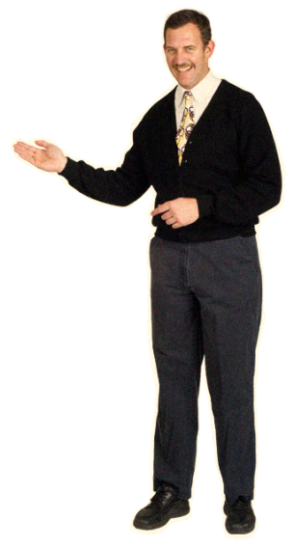
Questions??
Notes:
Planning time- spend 10 minutes making a game plan for yourself to be successful in the process. Use the provided handout for planning.

Slide 22
Planning for the Edges

Slide 23
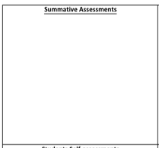
What Summative Data Can You Collect for
the Students in Your Class to Build a Profile?

Slide 24
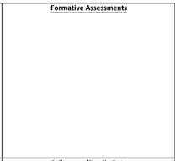
What Formative Data Can You Collect for
the Students in Your Class to Build a Profile?

Slide 25
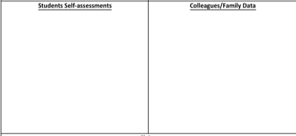
What Data Can You Collect From
Students, Parents, and Colleagues
to Build a Profile of Your Class?

Slide 26
Based on the data you have/will collect, what are at least 3 claims you can make about the student needs in your classroom- these needs should be aligned with the assessments and objectives of the unit

Slide 27
What professional learning needs have you identified for yourself? They must be grounded in the claims you made regarding student needs.

Slide 28
Backward Lesson Design
Step 1: Goals and Objectives
What do we want our
Students to know and be able
To do ?
Step 2: Assessments
How will I know if my
students have reached
The goal?
Step 3: Planning
-What learning activities
To I need to design to ensure
My students meet their goals
And objectives

Slide 29
Collaboration Time
Collaborate:
Like certificate
Same developmental span
Your Task is:
Connect Component 4 Standards to bulleted questions in Component 4 directions and forms.

Slide 30
Saturday March 3rd
8-10am
Homework:
-Data plan
-PLC Plan
Notes:
Next meeting

